Slide 1


Integration
Management Activity

Slide 2
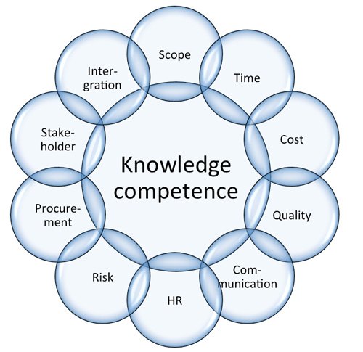
This purpose of this activity is begin to understand the relationships between the different knowledge areas
Different Knowledge Areas

Slide 3
To begin you need to get into groups of 8 or less.

Slide 4

One person in each group is to be responsible for a different knowledge area
(but NOT integration Management)

Slide 5
Every person should have a writing pad and a pen or pencil.
At the top of a blank page write your knowledge area.

Slide 6
Your task is to project manage a small concert that will be held in Perth.
You must choose the act(s), venue, date and time.

Slide 7
This will require a system to manage all the activities necessary to stage this event.

Slide 8
You must identify all the activities that need to be addressed.
As a group come up with a list of these activities.

Slide 9
Each knowledge area needs to analyse how each of the activities should be handled by their area.
Working independently of the other knowledge areas in your group list all the tasks that your area needs to address.

Slide 10
You now need to regroup with all the other people who were addressing the same knowledge area as you.

Slide 11
What did you find when you compared your tasks?
What problems did you have?
What would have helped?

Slide 12
Which knowledge area is the most important?

